Slide 1
Capital Structure and Leverage
BU8201 Tutorial 10
Lim Hui Hsing
Lee Ken Tat
Seet Qi Hao
Soh Kah Mun Nicholas

Slide 2
Summary
Business Risk → Riskiness of the firm’s assets if it uses no debt (All equity firm)
Depends on:
Operating Leverage → extent to which costs are fixed
Uncertainty on Demand (Sales)/Output prices/Input Costs
Ability to adjust sales prices in relation to changes in input costs
Ability to produce new products in a timely cost effective manner
Foreign Risk Exposure → Foreign exchange risk and political risk
Financial Risk → Additional risk placed on the common stockholders as a result of firm using debt
%
Risk
Uncertainty
Risk
Ability
Risk
Debt
Risk

Slide 3
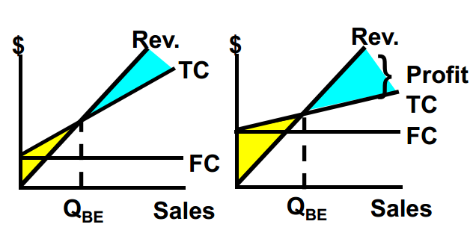
Summary
Operating Leverage→ Use of fixed costs rather than variable costs
Fixed Cost
Operating Leverage
Risk
Sales Decline
Profit
Decline

Slide 4
Summary
Financial Leverage → Use of debt and preferred stock
Financial Risk → additional risk concentrated on common stockholders as a result of financial leverage
Ratio used to Compare Leverage and Unleveraged Firms
BEP (Basic Earning Power) = EBIT/Total Assets
ROE (Return on Equity) = NI/Equity
TIE (Times Interest Earned) = EBIT/Interest Expense
Risk & Return for Leveraged(L) and Unleveraged(U) firms
E(BEP) → L=U
E(ROE)→ L>U
E (TIE) → U is infinity, L Has a rate
σROE → L>U
CVROE→ L>U

Slide 5
Summary
For Leverage to raise E(ROE), BEP must be greater than r_{d} (BEP>r_{d})
→interest expenses will be higher than operating income produced by debt-financed assets, so leverage will depress income
Debt increases, Interest expenses Increases
TIE decreases as EBIT is unaffected by debt

Slide 6
Summary
A firm needs capital to grow
Capital can be raised either through debt or equity
Setting the capital structure involves a trade-off between risk and return
The optimal capital structure maximises stock price and minimises WACC

Slide 7
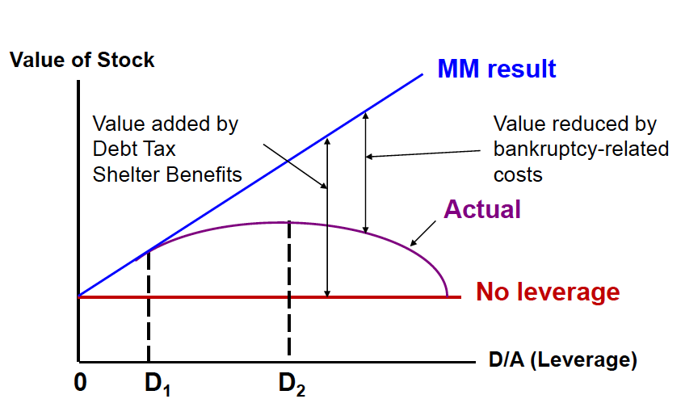
Summary
Modigliani-Miller Model (MM Model)
Tax benefits vs bankruptcy cost
As leverage increases, increased tax benefits and increased risk of bankruptcy and the value of firm is reduced by the higher bankruptcy-related costs.

Slide 8
Summary
Hamada Equation: b_{L}= b_{u} [1+ (1-T)(D/E)]
Used to separate the financial risk of a leveraged firm from its business risk
CAPM: r_{i} = r_{RF} + (r_{M} – r_{RF}) b_{i}
WACC: w_{d}r_{d} (1-T) + w_{p}r_{p} + w_{c}r_{s}

Slide 9
P15-5
The firms HL and LL are identical except for their leverage ratios and interest rates they pay on debt. Each has $20 million in assets, earned $4 million of EBIT, and is in the 40 percent federal-plus-state tax bracket. Firm HL, however, has a debt ratio (D/A) of 50 percent and pays 12 percent interest on its debt, whereas LL has 30 percent debt ratio and pays only 10 percent interest on its debt.
(a) Calculate the rate of return on equity (ROE) for each firm.
(b) Observing that HL has a higher ROE, LL’s treasurer is thinking of raising the debt ratio from 30 to 60 percent, even though that would increase LL’s interest rate on all debt to 15 percent. Calculate the new ROE for LL.

Slide 10
P15-5 (a)
Equations
ROE = Net Income/Equity
Debt Ratio = Total debt/Total assets
Equity = Assets – Debt
a) Calculate the rate of return on equity (ROE) for each firm.
Key Information | Firm HL | Firm LL
Assets | $20 million | $20 million
EBIT | $4 million | $4 million
Tax Rate | 40% | 40%
Debt Ratio | 50% | 30%
Debt Interest | 12% | 10%

Slide 11
P15-5 (a)
For Firm HL,
Debt = Debt Ratio / Tot. Assets = 50% X $20m = $10m
Debt Int. = 12% X Debt of $10m = $1.2m
EBIT | $4m
Debt Int. | $1.2m __________________
EBT (EBIT - Debt Int.) | $2.8m
Taxes (40% X EBT) | $1.12m __________________
NI (EBT-Taxes) | $1.68m __________________
Equity (Assets – Debt) | $10m
ROE = (Net Income/Equity) X 100% = 0.168 X 100% = 16.8%

Slide 12
P15-5 (a)
For Firm LL,
Debt = Debt Ratio / Tot. Assets = 30% X $20m = $6m
Debt Int. = 10% X Debt of $6m = $0.6m
EBIT | $4m
Debt Int. | $0.6m __________________
EBT (EBIT - Debt Int.) | $3.4m
Taxes (40% X EBT) | $1.36m __________________
NI (EBT-Taxes) | $2.04m __________________
Equity (Assets – Debt) | $14m
ROE = (Net Income/Equity) X 100% = 0.146 X 100% = 14.6%

Slide 13
P15-5 (b)
b) When Firm LL’s Treasurer raise the debt ratio from 30 to 60 percent and interest rate on all debt increased to 15%,
Key Information | Firm LL (Old) | Firm LL (New)
Assets | $20 million | $20 million
EBIT | $4 million | $4 million
Tax Rate | 40% | 40%
Debt Ratio | 30% | 60%
Debt Interest | 10% | 15%

Slide 14
P15-5 (b)
For Firm LL (New),
Debt = Debt Ratio / Tot. Assets = 60% X $20m = $12m
Debt Int. = 15% X Debt of $12m = $1.8m
EBIT | $4m
Debt Int. | $1.8m __________________
EBT (EBIT - Debt Int.) | $2.2m
Taxes (40% X EBT) | $0.88m __________________
NI (EBT-Taxes) | $1.32m __________________
Equity (Assets – Debt) | $8m
ROE = (Net Income/Equity) X 100% = 0.165 X 100% = 16.5%

Slide 15
P15-6
The Weaver Watch Company sells watches for $25; the fixed costs are $140,000 and the variable costs are $15 per watch.
(a) What is the firm’s gain or loss at sales of 8,000 watches?
At 18,000 watches?
(b) What is the breakeven point? Illustrate by means of a chart.
(d) What would happen to the breakeven point if the selling price were raised to $31 but variable costs rose to $23 per unit

Slide 16
P15-6 (a)
(a) Total Costs for 8,000 watches
= Total Fixed Cost + Total Variable Cost
= [$140,000 + (8000 x $15)]
= $140,000 + $120,000
= $260,000
Revenue from sales of 8,000 watches
$25 x 8,000
= $200,000
Profit/Loss = $200,000 - $260,000
= -$60,000
Firm will make a loss of $60,000 with sales of 8,000 watches.

Slide 17
P15-6 (a)
(a) Total Costs for 18,000 watches
= Total Fixed Cost + Total Variable Cost
= [$140,000 + (18000 x $15)]
= $140,000 + $270,000
= $410,000
Revenue from sales of 18,000 watches
$25 x 18,000
= $450,000
Profit/Loss = $450,000 - $410,000
= $40,000
Firm will make a profit of $40,000 with sales of 18,000 watches.

Slide 18
P15-6 (b)
(b)
$
Revenue
TC
FC
Q_{B}
Sales
Breakeven Point:
Q_{BE} = Fixed Costs / (Unit Price – Unit Variable Cost)
= $140,000 / $(25-15)
= 14,000

Slide 19
P15-6 (c)
With the selling price increasing to $31 and the variable cost to $23 per unit, there is a higher increase in variable cost than the selling price.
$
Revenue*
Revenue
TC*
TC
FC
Q_{B}
Q_{B*}
Sales

Slide 20
P15-6 (c)
As a result, the company would have a higher breakeven point.
Breakeven Point:
Q_{BE} = FC / (UP - UVC)
= $140,000 / $(31-23)
= 17,500

Slide 21
P15-11
Currently, Bloom Flowers Inc. has a capital structure consisting of 20 percent debt and 80 percent equity. Bloom’s debt currently has an 8 percent yield to maturity. The risk free rate (r_{RF}) is 5 percent, and the market risk premium (r_{M}-r_{RF}) is 6 percent. Using the CAPM, Bloom estimates that its cost of equity is currently 12.5 percent. The company has a 40 percent tax rate.
(a) What is Bloom’s current WACC?
(b) What is the current beta on Bloom’s common stock?
(c) What would Bloom’s beta be if the company had no debt in its capital structure? (That is, what is Bloom’s unlevered beta, B_{U}?)

Slide 22
P15-11 (a)
Debt Debt Ratio (D/A) : 20% = 0.2 r_{d} (YTM): 8% = 0.08 | Equity Equity Ratio (E/A): 80% = 0.8 r_{S} (cost of equity): 12.5% = 0.125 R_{RF} (risk-free rate) : 5% =0.05 R_{M} (Mkt risk premium) : 6% = 0.06
Tax (T): 40% =0.4
WACC = [(D/A) × r_{d} (1 – T)] + (E/A)(r_{s})
= [0.2 × 0.08(1- 0.4)] + (0.8)(0.125)
= 0.1096
= 10.96%

Slide 23
P15-11 (b) (c)
(b) r_{s}= R_{rf} + (R_{m})(b_{L})
0.125= 0.05 + (0.06)(b_{L})
0.06(b_{L}) = 0.075
b_{L} = 1.25
(c) b_{L} = b_{U} [ 1+ (1 – T) (D/E)
1.25 = b_{U} [ 1 + (1 - 0.4)(0.25)]
1.25 = 1.15 b_{U}
b_{U} = 1.086957
D/E = D/A × A/E = D/A ÷ E/ A = 0.2 ÷ 0.8 = 0.25

Slide 24
P15-11
Bloom’s financial staff is considering changing its capital structure to 40 percent debt and 60 percent equity. If the company went ahead with the proposed change, the yield to maturity on the company’s bonds would rise to 9.5 percent. The proposed change will have no effect on the company’s tax rate.
(d) What would be the company’s new cost of equity if it adopted the proposed change in capital structure?
(e) What would be the company’s new WACC if it adopted the proposed change in capital structure?
(f) Based on your answer to part e, would you advise Bloom to adopt the proposed change in capital structure? Explain.

Slide 25
P15-11 (d)
b_{L} = b_{U} [ 1+ (1 – T) (D/E)
= 1.086957 [ 1 + (1 - 0.4)(0.666)]
= 1.52174
D/E = D/A × A/E = D/A ÷ E/ A = 0.4 ÷ 0.6 = 0.666
r_{s}= R_{rf} + (R_{M})(b_{L})
= 0.05 + 0.06 (1.52174)
=0.141304
= 14.13 %

Slide 26
P15-11 (e)
WACC = [(D/A) × r_{d} (1 – T)] + (E/A)(r_{s})
= [0.4 × 0.095(1- 0.4)] + (0.6)(0.141304)
= 0.107582
= 10.76%

Slide 27
P15-11 (f)
Increases
Before | After
Debt ratio (D/A) = 20% (0.2) WACC = 10.96% | Debt ratio (D/A) = 40% (0.4) WACC = 10.76%
Decreases
Bloom is advised to adopt the proposed change in capital structure.
An increase in debt in favor of equity reduces WACC.

Slide 28
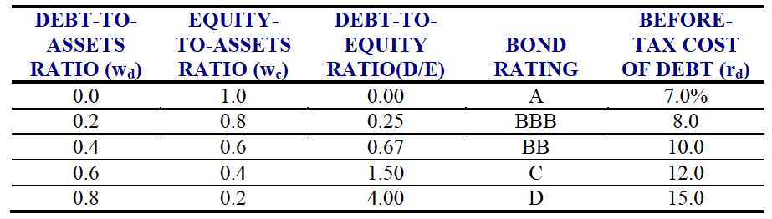
P15-14
Elliott Athletics is trying to determine its optimal capital structure, which now consists of only debt and common equity. The firm does not currently use preferred stock in its capital structure, and it does not plan to do so in the future. Its treasury staff has consulted with investment bankers and, on the basis of those discussions, the staff has the following table showing its debt cost at different levels:

Slide 29
P15-14 (a)
Elliott uses the CAPM to estimate its cost of common equity, r_{S} . The company estimates that the risk-free rate is 5 percent, the market risk premium is 6 percent, and its tax rate is 40 percent. Elliot estimates that if it had no debt, its “unlevered” beta, b_{U}, would be 1.2.
(a) What is the firm’s optimal capital structure, and what would be its WACC at the optimal capital structure?

Slide 30
P15-14 (a)
D/A | E/A | D/E | r_{d} | r_{d}(1-T) | b_{L} | r_{s} | WACC
0.0 | 1.0 | 0.00 | 7 | 4.2 | 1.20 | 12.20 | 12.20
0.2 | 0.8 | 0.25 | 8 | 4.8 | 1.38 | 13.28 | 11.58
0.4 | 0.6 | 0.67 | 10 | 6.0 | 1.68 | 15.09 | 11.46
0.6 | 0.4 | 1.50 | 12 | 7.2 | 2.28 | 18.68 | 11.79
0.8 | 0.2 | 4.00 | 15 | 9.0 | 4.08 | 29.48 | 13.09
1. r_{d}(1-T) = 0.6r_{d} = 0.6(10) = 6.0%
2. Hamada Equation: b_{L} = b_{U}[1+ (1-T)(D/E)]
= 1.2[1+ 0.6(0.6667)]
= 1.2(1+ 0.4)
= 1.68%

Slide 31
P15-14 (a)
D/A | E/A | D/E | r_{d} | r_{d}(1-T) | b_{L} | r_{s} | WACC
0.0 | 1.0 | 0.00 | 7 | 4.2 | 1.20 | 12.20 | 12.20
0.2 | 0.8 | 0.25 | 8 | 4.8 | 1.38 | 13.28 | 11.58
0.4 | 0.6 | 0.67 | 10 | 6.0 | 1.68 | 15.09 | 11.46
0.6 | 0.4 | 1.50 | 12 | 7.2 | 2.28 | 18.68 | 11.79
0.8 | 0.2 | 4.00 | 15 | 9.0 | 4.08 | 29.48 | 13.09
3. CAPM: r_{S} = r_{RF} + (r_{M} – r_{RF})b_{L}
= 5 + 6bL
= 5 + 6(1.68)
= 15.08%
4. WACC = (D/A) x r_{d}(1-T) + (E/A) x r_{S}
= 0.4(6.0) + 0.6(15.08) = 2.4 + 9.048
= 11.45%

Slide 32
P15-14 (b)
(b) If Elliot’s managers anticipate that the company’s business risk will increase in the future, what effect would this increase likely have on its target capital structure?

Slide 33
P15-14 (b)
Advantages of debt:
- Interest on business debt is tax deductible.
- Pay less dividends
- More control: Unlike equity investors, creditors don’t get a vote in how you run your business.
Disadvantages of debt:
- Firm increases its financial risk.
- Firm’s bond rating to deteriorate.
- Cost of debt increases.
When business risk increases, it becomes more disadvantages to use debt while the benefits remains the same. Thus we should decrease usage of debt.

